Slide 1
Analysis on
Accidental Deaths and Suicide
In India
CS685 Project
Group-20:
Manjyot Singh Nanra
Akshay Kumar Chittora
Jeet Sarangi
Akash Dayanand Chavan
Rohit Kulhari

Slide 2
Introduction
Loss of lives due to accident and suicides result in irreparable damages to the families and society at large.
Exhaustive information on accidents and suicide is of utmost importance to carry out any meaningful study and devise appropriateintervention measure.
In this project we aim to perform analysis on the accidental deaths and suicide data for India.

Slide 3
Problem Statement
Suicide Data Analysis
Cause based Analysis
Means/Modes based analysis
Economic Status based analysis
Profession Bases Analysis
Literacy Groups based analysis
Social Status Based Analysis
Overall Trend Analysis
Accident Data Analysis
Overall Trend Analysis

Slide 4
Motivation
Approximately 1.5% of all deaths worldwide are by suicide. India itself recordedaround 419 suicide deaths daily for the year of 2020.
The effects of suicide aretragic and felt long after the individual has taken their own life.
Every step that can help towards prevention of precious lives is helpful.
Hence we are motivatedto do analysis on suicide data so that we can get more insights on groups orstates regarding on suicide numbers and take appropriate action.
Goal of this is that in future, required authorities can use this analysis to take appropriate decisions to mitigate these problems

Slide 5
Dataset(sources)
Open Government Data Platform(Data.gov.in)
National Crimes Records Bureua (NCRB)

Slide 6
Data Cleaning
Processing PDF Files
Cleaning CSV Files
Merging common CSV files

Slide 7
Data Analysis
Education Analysis
Cause Wise Analysis
Social Data Analysis
Economic Data Analysis
Profession Data Analysis
Means Adopted Data Analysis
Overall Suicide Analysis
Overall Accident Analysis

Slide 8
Results

Slide 9
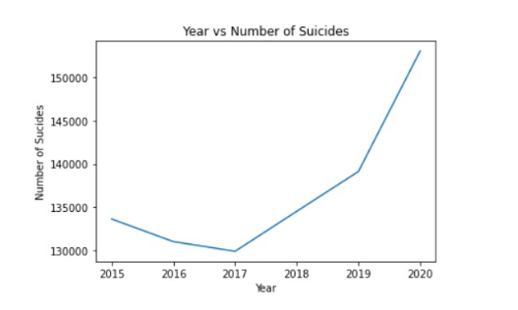
Year Wise Suicide

Slide 10
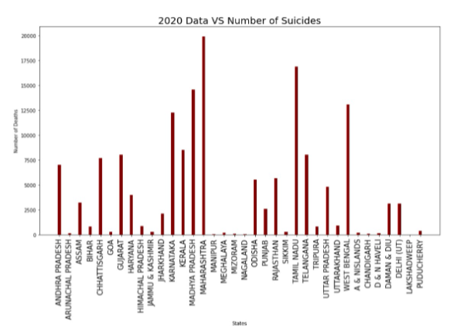
Number of suicides vs States

Slide 11
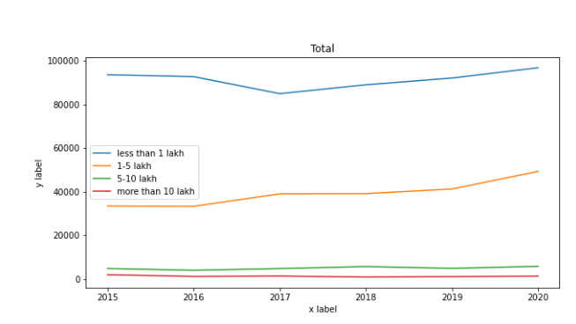
Economic status vs Years Suicide

Slide 12
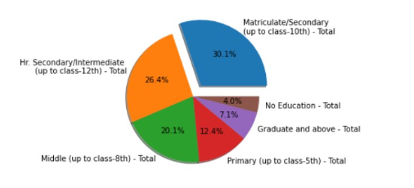
Education group distribution

Slide 13
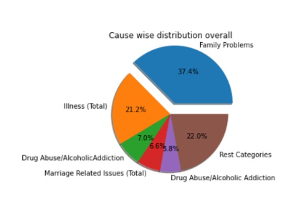
Cause Wise Distribution of suicides

Slide 14
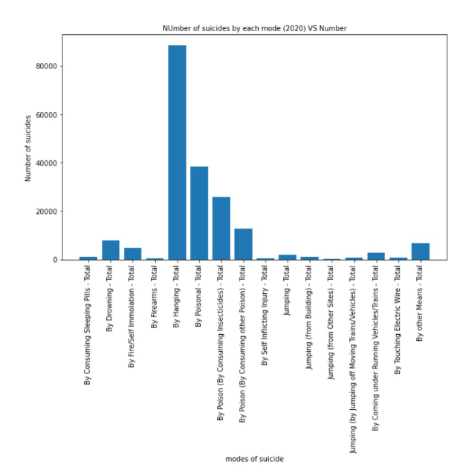

Slide 15
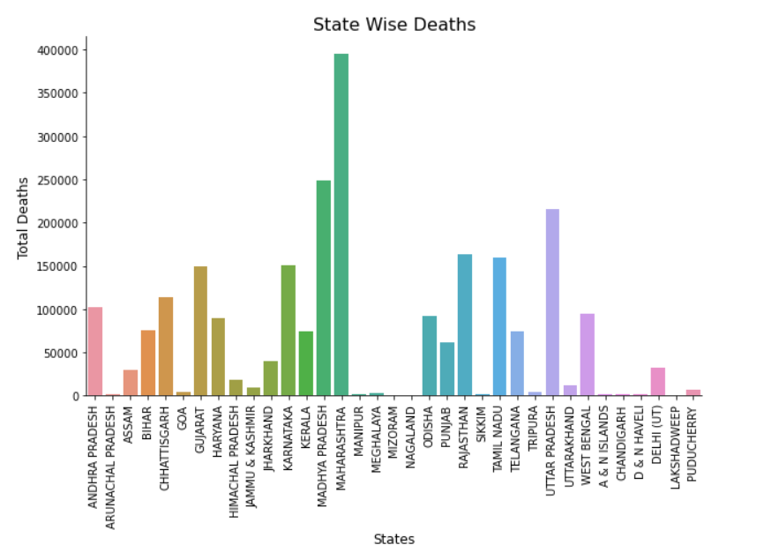

Slide 16
Way ahead….
We were only able to analyse data from 2015-2020. We aim to analyse data from previous years too.
Data before 2015 was not organized well so it would lots of manual preprocessing. We aim to pursue this in future so that useful data is available.

Slide 17
Thank you!

